Slide 1
Fishbone Diagram & Forcefield Analysis

Slide 2
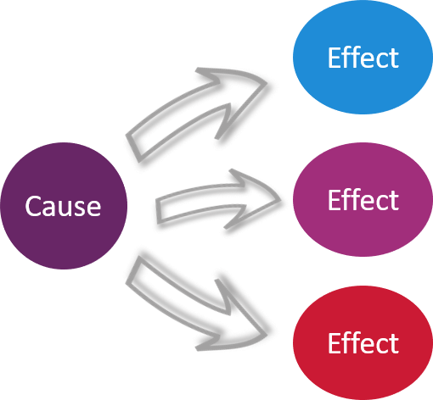
Fishbone Diagram- What Is It?
A cause-and-effect diagram, a “fishbone” diagram, can help in brainstorming to identify possible causes of a problem and in sorting ideas into useful categories.
A fishbone diagram can be helpful in identifying possible causes for a problem that might not otherwise be considered by directing the team to look at specific categories and think of alternative causes.
This Photo by Unknown Author is licensed under CC BY

Slide 3
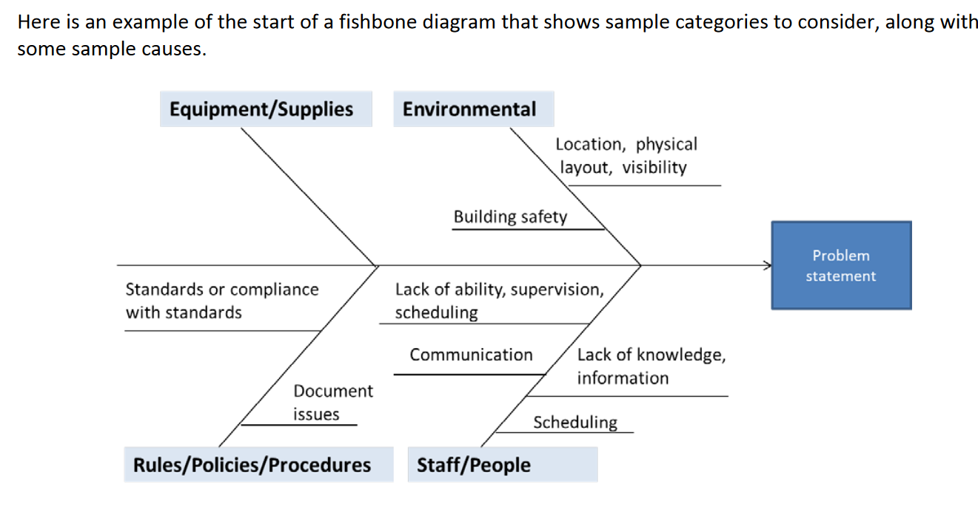
Fishbone Diagram: How-To’s
The problem or effect is displayed at the head or mouth of the fish.
Possible contributing causes are listed on the smaller “bones” under various cause categories.

Slide 4
Tips for Completing The Fishbone Diagram
Use the fishbone diagram tool to keep the team focused on the causes of the problem, rather than the symptoms.
Consider drawing your fish on a flip chart or large dry erase board to get you started.
Make sure to leave enough space between the major categories on the diagram so that you can add minor detailed causes later.
When you are brainstorming causes, consider having team members write each cause on sticky notes, going around the group asking each person for one cause. Continue going through the rounds, getting more causes, until all ideas are exhausted.
Encourage each person to participate in the brainstorming activity and to voice their own opinions.
To help identify the root causes from all the ideas generated, consider a multi-voting technique such as having each team member identify the top three root causes. Ask each team member to place three tally marks or colored sticky dots on the fishbone next to what they believe are the root causes that could potentially be addressed.

Slide 5
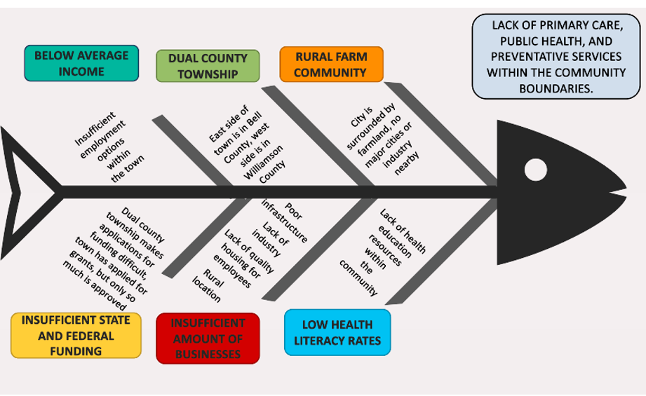
A Completed Fishbone Diagram
This Fishbone depicts a breakdown of the group’s perception of the main community issue: lack of local primary care and preventative services to community members.
Major factors contributing to this problem is the lack of available health resources.
The impoverished status of the community combined with insufficient industry within the town.
One of the major issues for the community is dual county township status: the mayor and other city officials have to go through twice as many channels to implement policy changes for the community.
Low health literacy rates among community members contributes to a higher number of preventable health issues.

Slide 6
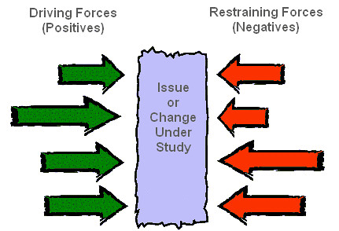
Force Field Analysis:
Force field analysis is a basic tool for root cause analysis.
The technique is based on the assumption that any situation is the result of forces for and against the current state being in equilibrium.
Countering the opposing forces and/or increasing the favorable forces will help induce a change by reinforcing positives and eliminating or reducing negatives.
Force field analysis does the following:
Presents the positives and negatives of a situation so they are easily comparable.
Considers all aspects of making the desired change.
Encourages agreement about the relative priority of factors on each side of the balance sheet.
Encourages honest reflection on the underlying roots of a problem and its solution.
What Is It?
This Photo by Unknown Author is licensed under CC BY-SA-NC

Slide 7
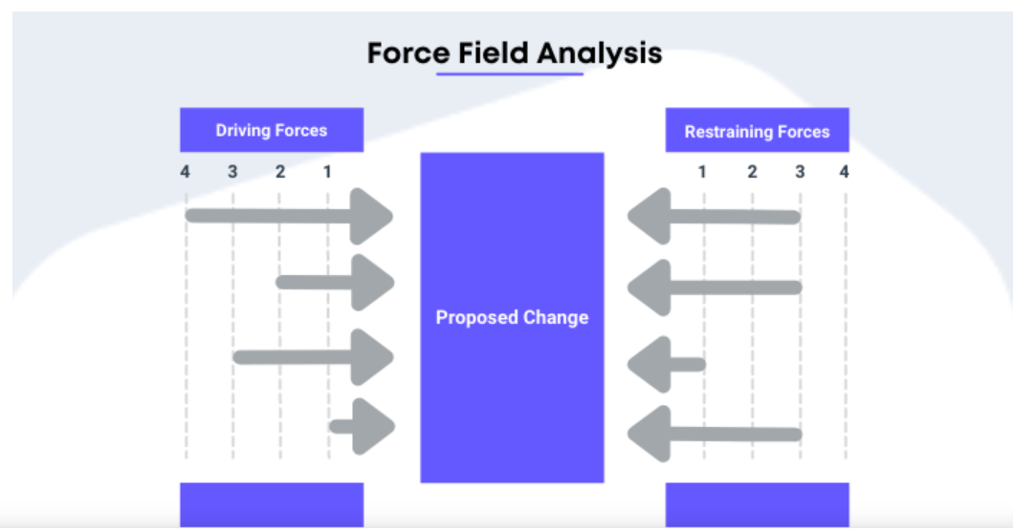
Force Field Analysis How To’s:
Conduct a force field analysis through the following steps:
Brainstorm all possible forces inside and outside the organization that could work for or against the solution.
Assess the strength of each of the forces (1-4)- NOTE: You can set it 1-5 if you want!
Place the forces in a force field diagram, with the length of each arrow in the diagram proportional to the strength of the force it represents.
For each force, but especially the stronger ones, discuss how to increase the forces for the change and reduce those against it.

Slide 8
A Completed Force Field Analysis
Issue: Lack of readily accessible primary and preventative healthcare services for the community of Bartlett, TX
Identified Change: Improved Medicaid beneficiary services through paramedicine outlined in Senate Bill No. 2028

