Slide 1
Pediatric
Simulation

Slide 2
Simulation Goals
Utilize
Utilizing critical thinking and decision-making skills.
Identify
Identify priority nursing actions based on assessment and clinical data.
Perform
Perform pediatric physical exam.
Reassess
Reassess/monitor patient status following nursing interventions.
Communicate
Communicate in a manner that is developmentally appropriate.

Slide 3
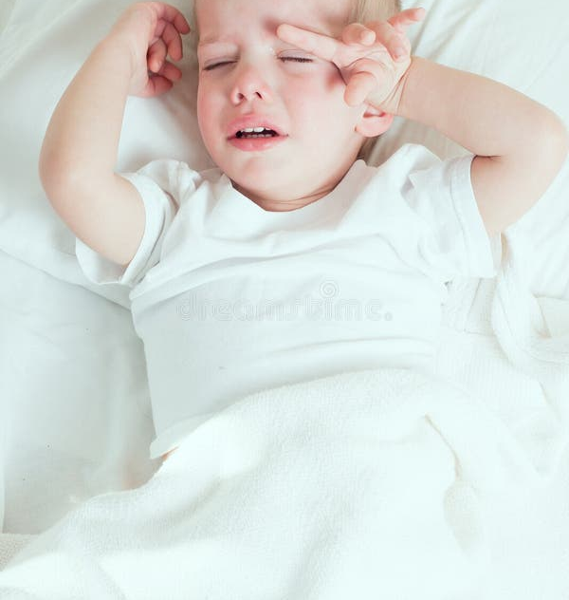
Meet Our Patient:
Peter Pan

Slide 4
Past Medical History
Normal spontaneous vaginal delivery at 40 weeks.
No major illnesses or hospitalizations. Has had 2 ear infections, treated with amoxicillin; last infection about 2 years ago.
Mother reports he has had well child visits since birth and is up to date with immunizations.

Slide 5
Social History
Patient lives with Mom and younger sibling.
Mom employed full-time. Patient is in Kindergarten and sister is in day care full-time.
Mom has no concerns about patient’s speech or development.

Slide 6
History Of Presenting Illness
Patient (5-year-old male) began vomiting 2 days ago. Vomiting 3-5 times/day. This morning patient had one loose stool. Per Mom the patient stated, "my tummy hurts." Patient will drink normally but then refused any food. Mom brought patient to primary care office for acute care visit.
No one at home is ill.
Exam: Patient weighs 55 pounds, patient appears ill, crying tears when nurse/provider exam patient. Mucous membranes dry, skin turgor good, cap refill brisk, abdomen soft and flat, +BS, HR 115, RR 22, BP 96/70.
Notes:
Normal HR 85-160, RR 17-65

Slide 7
Outpatient Treatment Plan
Diagnosis: Gastroenteritis
  Plan: encourage fluids, bland diet, return if does not improve
  Teaching: Appropriate fluids to rehydrate, BRAT diet, S/S of dehydration and when to return to ER
Patient to be discharged home from primary care office.

Slide 8
Evolving History Of Presenting Illness
Peter’s Mom brought him to the ER 2 days later. He is now being admitted to pediatric unit.
He began vomiting 4 days ago, after spending the day at kindergarten. Lots of kids are now sick from school. Vomiting progressed from 3-4 to 6-8 times/day. Diarrhea began 1 days ago, progressed to 10 episodes of runny green stools through the day today. Initially he would eat crackers and drink apple juice but then refused any food or fluids since last night. Mom has tried over–the-counter oral rehydration solutions with no success. Peter had not voided for over 12 hours. Mom states he is very tired.
Notes:
Normal HR 85-160, RR 17-65
2 days ago, HR 115, RR 22, 96/70

Slide 9
What do you think based off the history?

Slide 10
ER Exam and Findings
Peter Pan 5-year-old
Weight: 52 pounds
NKDA
Patient appears ill, slightly lethargic, held by Mom. Responds by crying when touched or vitals are taken.
Minimal tears when crying. Mucous membranes very dry, skin turgor shows tenting, cap refill 3, abdomen soft and flat, +BS, Skin is warm and pale. Underwear is dry.
Vitals: HR 140, RR 30, BP 80/59 Temperature 39.0.
Last emesis 30 min ago after being offered a sip of sugar free Gatorade.
Notes:
Normal HR 85-160, RR 17-65
2 days ago, HR 115, RR 22, 96/70

Slide 11
Diagnosis
Gastroenteritis
Dehydration

Slide 12
Simulation Time!
Orient to Space/Room
How to to “call” provider
Vitals signs
Supplies
TO DO:
Assign Roles
Receive Hand-off

Slide 13

As a simulation group things to consider:
  What is the primary concern?
  What will be the focus of the assessment?

Slide 14
Admission Orders
Name: Peter Pan DOB: 5 years prior to today
Weight : 52 Allergies: NKDA
Vitals on admission and Q4 hours
Cardiac Monitor and Pulse Ox
O2 to keep Oxygen Sats >95%
IVF bolus: 20ml/kg of NS IV given push/pull
D5NS @ 97 ml/hr
Tylenol PO 15 mg/kg per dose Q 4 hours for pain/fever
Activity as Tolerated
Strict I+O
Diet: Clear liquids and oral meds

