Slide 1


self care meditation
Dr. Ambrosio Mawhirter

Slide 2
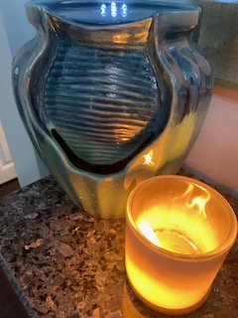
What is Meditation?
“Meditation is not passive sitting in silence. It is sitting in awareness, free from distraction, and realizing the clear understanding that arises from concentration.”
— Nhat Hanh

Slide 3


Meditation
The National Center for Complementary and Integrative Health (NCCIH), a U.S. government entity within the National Institutes of Health (NIH), states:
“There are many types of meditation, most of which originated in ancient religious and spiritual traditions.”
Meditation has a long history of use for increasing calmness and physical relaxation, improving psychological balance, coping with illness, and enhancing overall health and well-being.
Research suggests that meditation may physically change the brain and body and could potentially help to improve many health problems and promote healthy behaviors.
retrieved from :https://www.nccih.nih.gov/

Slide 4
Worth a Try…
“Meditation can help nurses handle day-to-day workplace stress in a safe and positive fashion, leading to improvements in physical and mental health.
Meditation has shown to have benefits related to decreasing insomnia, high blood pressure, and depression, this free and simple mind-body technique has much to offer.
Understanding meditation:
Meditation has been practiced for thousands of years. Meditation originally was meant to help deepen understanding of the sacred and mystical forces of life. These days, meditation is commonly used for relaxation and stress reduction.
Meditation is considered a type of mind-body complementary medicine. Meditation can produce a deep state of relaxation and a tranquil mind.
During meditation, you focus your attention and eliminate the stream of jumbled thoughts that may be crowding your mind and causing stress. This process may result in enhanced physical and emotional well-being.”
Retrieved from:https://www.mayoclinic.org/tests-procedures/meditation/in-depth/meditation/art-20045858

Slide 5
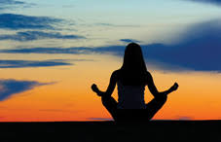
Meditation and emotional and physical well-being
When you meditate, you may clear away the information overload that builds up every day and contributes to your stress.
The emotional and physical benefits of meditation can include:
Gaining a new perspective on stressful situations
Building skills to manage your stress
Increasing self-awareness
Focusing on the present
Reducing negative emotions
Increasing imagination and creativity
Increasing patience and tolerance
Lowering resting heart rate
Lowering resting blood pressure
Improving sleep quality
Retrieved from :https://www.mayoclinic.org/tests-procedures/meditation/in-depth/meditation/art-20045858#

Slide 6

Types of Meditation Practices
Breath Awareness:
It grounds us in our bodies. If we stay with the breath — each inhale, each exhale — then we stay connected with the present moment. May be used to decrease anxiety.
Body Scan:
Start at the top of your head. Pay attention to sensations, any feelings of tightness or resistance. Can you relax this area at all? Then work down to your forehead, and again pay attention to sensations and tightness, relaxing that area. Work your way down slowly — focusing on your eyes, cheeks, jaw, neck, shoulders, arms, chest, abdomen, fingers — down to your toes. Just like a breath meditation, this practice grounds you in the present moment, and it creates a systematic way to release you from the stress your body holds from the past.
Guided Meditation:
Guided meditations are available on apps, Youtube and can be geared toward many types of goals, like sleep, focus, happiness, confidence, and relaxation. Some have background music and sounds, some do not. Some involve word repetition, and others you'll listen to silently. Try different types to find a guided meditation that matches your personality and needs. .
Retrieved from https://www.bestcolleges.com/blog/meditation-for-college-students/

Slide 7

American Holistic Nurse Resources
Progressive Muscle Relaxation :
https://www.ahna.org/Portals/66/Docs/Resources/Resilience/Progressive%20Muscle%20Relaxation%20(PMR)%20for%20Resilience.pdf?ver=EUBNs2bOAsQs-NKZGbDJ3g%3d%3d
Breath work:
https://www.ahna.org/Portals/66/Docs/Resources/Resilience/Breathwork%20for%20Resilience.pdf?ver=2020-04-17-155341-067
Guided Imagery :
Forest:
https://www.ahna.org/Portals/66/Docs/Resources/Resilience/Forest%20Guided%20Imagery%20for%20Resilience.pdf?ver=2020-05-04-154227-167
Beach:
https://www.ahna.org/Portals/66/Docs/Resources/Resilience/Beach%20Guided%20Imagery%20for%20Resilience.pdf?ver=2020-04-28-130545-893
Centering:
https://www.ahna.org/Portals/66/Docs/Resources/Resilience/Centering%20for%20Resilience.pdf?ver=2020-06-30-142911-880
https://www.ahna.org/Resources

Slide 8
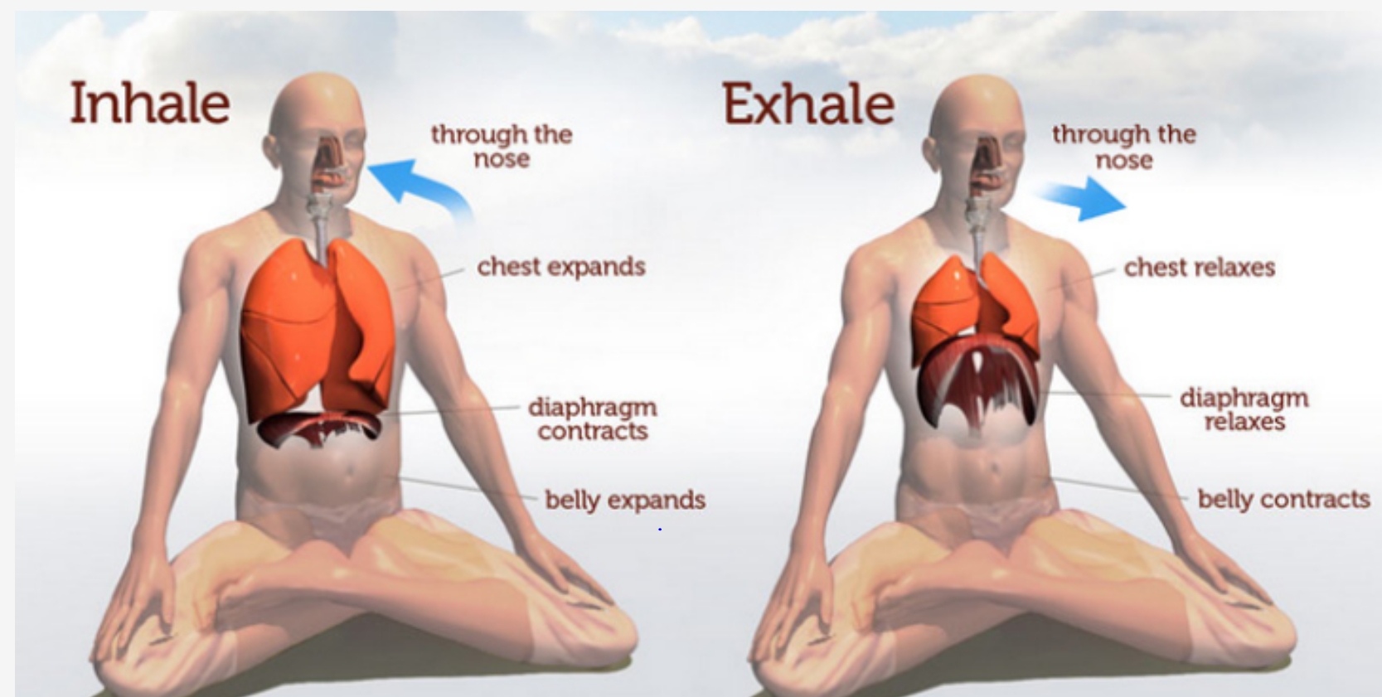
Breathing techniques – Can be done anywhere….
The Science: Diaphragmatic Breathing originates in the belly, drawing the diaphragm downward into the abdominal cavity. Stress release occurs during slow full breaths from your abdomen instead of short shallow breaths from your chest.
https://www.ahna.org/Home/Resources/Self-Care-and-Resilience
Picture retrieved from: https://www.ahna.org/Portals/66/Docs/Resources/Resilience/Breathwork%20for%20Resilience.pdf?ver=2020-04-17-155341-067
To get the desired effects regular practice is necessary.
Scheduling time to mindfully breathing,regular practice you may feel calmer and less stressed!
References: Cronkleton, E. (2019, April 09). 10 Breathing Exercises to Try: For Stress, Training &amp; Lung Capacity. Retrieved July 19, 2020, from https://www.healthline.com/health/breathing-exercise

Slide 9

meditation resources:
Mindful Breathing :
https://youtu.be/I-SFdhVwrVA
https://youtu.be/oo2E5Z_Cxvk
Box Breathing:
https://youtu.be/tEmt1Znux58
5 Minute Meditation You Can Do Anywhere:
https://youtu.be/inpok4MKVLM
Guide Meditation- letting go of stress (20min)
https://youtu.be/-JyoHcF5oQ4
Guided Meditation- a trip to the beach (20min)
https://youtu.be/-JyoHcF5oQ4
Progressive relaxation guided meditation (20min)
https://youtu.be/QVgEqP2OkYc

Slide 10

You might want to know More … resources ….
Mayo Clinic: Meditation: A simple, fast way to reduce stress
https://www.mayoclinic.org/tests-procedures/meditation/in-depth/meditation/art-20045858
National Center for Complementary and Integrative Health: Meditation: In Depth
https://www.nccih.nih.gov/health/meditation-and-mindfulness-what-you-need-to-know
American Heart Association: Stress Reduction in the Secondary Prevention of Cardiovascular Disease
https://www.ahajournals.org/doi/10.1161/CIRCOUTCOMES.112.967406

Slide 11
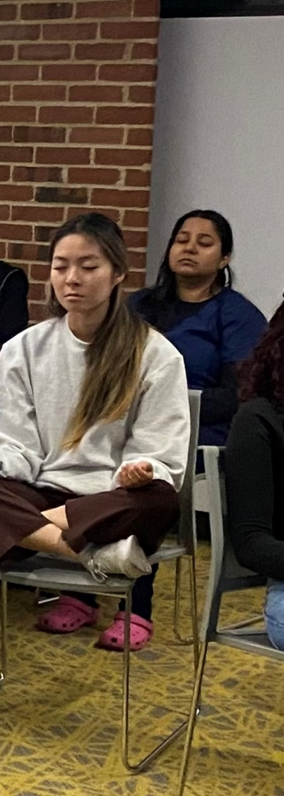
When practicing mindfulness meditation or teaching someone how to do so, consider these tips:
Choose your meditation location. This can be anywhere, including a quiet or noisy environment.
Find a comfortable position.
Carve out some time. This can be as little as 1 minute or as long as desired.
Pay attention to your breathing. It may be beneficial to focus on the rise and fall of your chest or count your breaths in and out.
Notice the sensations that you're feeling.
Recognize your thoughts.
Recognize your emotions.
Pay attention to bodily sensations.
If your mind wanders, it's okay. Just recognize that your mind has wandered and return focus to your breathing.
For some, it may be beneficial to mentally repeat a mantra, which is a sound, prayer, or meaningful phrase, as opposed to focusing on breathing.
Don't become discouraged if your mind frequently wanders because it takes practice and patience to become proficient at meditation.
Retrieved from https://journals.lww.com/nursingmadeincrediblyeasy/fulltext/2020/03000/mindfulness_meditation__creating_positive_changes.4.aspx

Slide 12

Slide Title
Mindful Breathing, You can start….
Set a timer for 2-5 minutes and practice one of the following exercises (Cronkleton, 2019):
Pursed Lip Breathing
  Relax your neck and shoulders.
  Keeping your mouth closed, inhale slowly through your nose for 2 counts.
  Pucker or purse your lips as though you were going to whistle.
  Exhale slowly by blowing air through your pursed lips for a count of 4.
Breath Focus Technique
  Sit or lie down in a comfortable place.
  Bring your awareness to your breaths without trying to change how you’re breathing.
  Alternate between normal and deep breaths a few times. Notice any differences between normal breathing and deep breathing. Notice how your abdomen expands with deep inhalations.
  Note how shallow breathing feels compared to deep breathing.
  Practice your deep breathing for a few minutes.
  Place one hand below your belly button, keeping your belly relaxed, and notice how it rises with each inhale and falls with each exhale.
  Let out a loud sigh with each exhale.
  Begin the practice of breath focus by combining this deep breathing with imagery and a focus word or phrase that will support relaxation.
  You can imagine that the air you inhale brings waves of peace and calm throughout your body. Mentally say, “Inhaling peace and calm.”
  Imagine that the air you exhale washes away tension and anxiety. You can say to yourself, “Exhaling tension and anxiety.”

Slide 13





meditation apps you can download
Calm
Headspace
Aura.
Stop, Breathe and Think.

Slide 14

Your Challenge for the week:
Meditate…...

Slide 15
References
American Holistic Nurses Association (AHNA). (2016). Self-care: finding time and balance. Beginnings; (36)4.
American Holistic Nurses Association (AHNA). (2015). Holistic nourishment for healing & resilience. Beginnings, (35)6, 21.
Bennett, M. (2015). It's about resilience. American Holistic Nurses Association (AHNA). Beginnings, (35)6, 6-9, 26-27.
Cronkleton, E. (2019, April 09). 10 Breathing Exercises to Try: For Stress, Training &amp; Lung Capacity. Retrieved July 19,
2022, from https://www.healthline.com/health/breathing-exercise
Perkins, A.,( 2020). Mindfulness meditation. Made Incredibly Easy!: Vol 18 (2),p14-18.doi: 10.1097/01.NME.0000653224.00489.d7
Rovinsky, P. (2015). Stress and resiliency: Challenges of 21st century living. American Holistic Nurses Association (AHNA). Beginnings, (35)6, 18-20.
Rosa, W. (2014). Caring science and compassion fatigue: Reflective inventory for the individual processes of self- healing. American Holistic Nurses Association (AHNA). Beginnings; 34(4), 18-20.
Schroeder, T. (2017). Meditation for emotional well-being. American Holistic Nurses Association (AHNA). Beginnings; 37(3), 10-11.
World Health Organization, 2016. http://apps.who.int/medicinedocs/en/d/Jwhozip32e/3.1.html
Retrieved 8/2022 from: https://journals.lww.com/nursingmadeincrediblyeasy/fulltext/2020/03000/mindfulness_meditation__creating_
positive_changes.4.aspx

