Slide 1
John’s Journey
Caring for Vulnerable Populations in the Community

Slide 2
Goals of this Case Study
Assess a community to determine how social determinants of health impact the health, healthcare, and needs of a community.
Analyze data such as demographics, morbidity and mortality rates to determine the prevalence of health risks and assets within a population.
Interpret findings to determine the priority problem within a community.
Develop intervention goals for a population based on the community health nursing diagnosis.
Analyze the possible risks and benefits of healthcare options for a client.
State the client’s priority health needs.
List the appropriate community resources that are available to the client and his family.
Develop a care plan for the client and his family.
Discuss the client’s health education needs.
Demonstrate communication principles and interprofessional healthcare team collaboration for continuity of care.
Write a community health nursing diagnosis.
Discuss appropriate health promotion interventions for the client.

Slide 3
Synopsis of the Case Study
Figure 1. Finger Pressing Button. Adapted from “Optizen Labs”, retrieved from http://optizenlabs.com/pl/tag/case-study/

Slide 4
John’s Journey
As you work through Mr. John Miller’s case study, you will find links to data sources regarding the community.
Analyze the data presented to help you consider the questions found throughout the case study. As you will see, often there is more than one correct answer to a question or more than one way to meet the needs of the community and its residents.
As you read through Mr. Miller’s story, consider the factors in his community which impact his health and his family. Many communities often lack many services that contribute to community health such as grocery stores, transportation, affordable and available health care, and affordable childcare.
After you read through the case study, there will be questions for you to answer. Interventions must be tailored to address problems specific to a community.

Slide 5
John Miller
35-year-old combat veteran
Amputee
Divorced
Unemployed
Caretaker for his daughter with Autism
Has post traumatic stress disorder
Has a substance abuse disorder
Figure 2. Early military photo of Army. Printed with permission from S. Justin.
Notes:
Add Photo SP here.

Slide 6
Sophie Miller
John’s 5-year-old daughter
Has a diagnosis of autism with a moderate speech delay
Receives speech, occupational, and behavioral therapy services
Figure 3. Alexander. (2020, January 16) Sophie going to school.

Slide 7
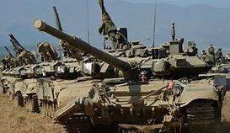
John’s Military Life
John joined the military after graduating from high school. He was a tank driver in the Army' 1st Armored Division.
His first duty station was Fort Bliss, Texas and after two months of service, he was deployed to New Orleans during Hurricane Katrina.
John completed two tours in Iraq and served a total of six years in the military.
He received an Other Than Honorable Discharge after being involved an off-base fight with a fellow platoon member.
He has a service-connected disability of PTSD from combat in Operation Iraqi Freedom (OIF) and Operation Enduring Freedom (OEF).
Figure 4. Military tank. Adapted from “Sputnik News”, retrieved from https://sputniknews.com/military/201609111045187046-russia-tank-division-formation/

Slide 8
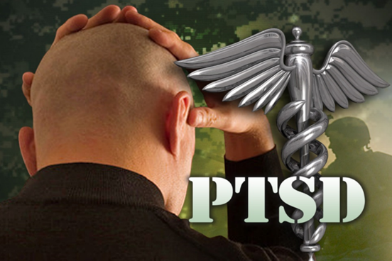
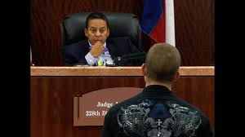
Becoming a Civilian
PTSD
Camp Hope
How does PTSD make integrating into civilian life more difficult for veterans?
What are some factors in John’s military history which contributed to his PTSD?
What are the limitations associated with a less than honorable discharge?
Figure 5. Soldier suffering from PTSD. Adapted from “KLSA News”, retrieved from https://www.ksla.com/story/22110456/ptsd-treating-the-silent-enemy-with-hearts-4-heroes/
Figure 6. Camp Hope building sign. Adapted from “Watchtower Security”, retrieved from https://watchtower-security.com/camp-hope-providing-new-hope-to-veterans-and-their-families/
Veteran Demographics
Figure 7. Defendant standing before a judge. Adapted from “Judge Marc Carter”, retrieved from https://judgemarccarter.com/
Figure 8. Military discharge notice. Adapted from “Military Benefits”, retrieved from http://militarybenefitspangeshi.blogspot.com/2017/06/military-benefits-dishonorable-discharge.html
Veterans Court
Life After Other Than Honorable Discharge
Military Separation Codes

Slide 9
John and Sophie
John worked as an electrician’s apprentice in Baytown earning $15/hr.
He worked 40 hours a week and sought overtime when his daughter’s schedule allowed.
This job did not provide him with health insurance, but Sophie qualified for Medicaid due to her father’s low income and her disability.
John began classes at a technical school to become an electrician but was unable to complete this program due to Sophie’s therapy schedule and his PTSD symptoms.
Figure 9. Electrician Cartoon. Adapted from “The Balance Careers”, retrieved from https://www.thebalancecareers.com/electrician-526009

Slide 10
Housing Costs
Food Costs
Autism Treatment
Housing is the biggest expense in one’s budget.
Housing Costs in Baytown
Cost of Living Calculator
What is the cost of living in Baytown?
How much would a two-bedroom apartment cost in Baytown?
What expenses must be factored into determining the cost of living?
Many people living in poverty experience food insecurity.
John and Sophie survive mostly on cold cereal and peanut butter sandwiches. Fruit and vegetables are rare luxuries for them. They also get food from a local food pantry to fill in the gaps between checks.
Food Costs in Baytown
Hungry in America
Going Hungry
What is food insecurity? What are the three components of food insecurity?
How does food insecurity impact Americans?
Autism
Autism Treatment
What therapy and treatment will Sophie require?
Are these resources available in Baytown?
Considerations:
Unemployment
How would John’s PTSD prevent him from being able to pursue education and employment?

Slide 11
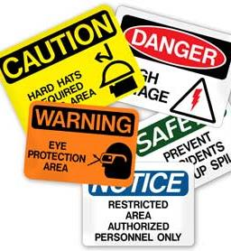
Workplace Injuries
After three and a half years of working as a civilian, John’s left arm was amputated in a work-related accident.
Injury Statistics
On-the-Job Injuries
What are the most dangerous jobs?
What are the most common on-the-job injuries?
Why are men more at risk of fatal or serious
work-related injuries.
Figure 10. Workplace Injury Prevention Signs. Adapted from “Hive Health Media”, retrieved from https://www.hivehealthmedia.com/workplace-injury-prevention/

Slide 12
Unemployment and Disability
After losing his job, John applied to the Veteran’s Administration for healthcare benefits and was granted some benefits related to his PTSD.
He also received worker’s compensation to pay for his injury-related expenses and receives worker’s compensation lifetime income benefits. If John’s weekly gross income from his job was $600, how much is his income from worker’s compensation?
He sought employment elsewhere but was unsuccessful.
John’s only source of income is worker’s compensation. He also receives $355 per month in food stamps or SNAP benefits. Sophie receives Medicaid because of her disability and low income. Sophie is not eligible to receive monthly payments from SSI as the family income is too high to qualify. John and Sophie do not qualify for Temporary Aid to Needy Families (TANF) as their income is too high.
What is worker’s compensation insurance?
Worker's Compensation
How much does worker’s compensation pay and how long can one receive these benefits?
Benefits
How does one qualify for SSI?
SSI for children
What are the criteria for receiving TANF?
TANF
What is the average amount of food stamps that a family can receive per month?
SNAP

Slide 13
What are the social determinants of health?
SDOH may result in differences in health and health care across populations. Environmental and social conditions may lead to inequities in access to health care and availability of health care, leading to health disparities.
The social determinants of health are essential to community health.
The SDOH often explain why some people and communities thrive while others struggle.
Social determinants of health (SDOH) are the conditions in the environments where people are born, live, learn, work, play, worship, and age that affect a wide range of health, functioning, and quality-of-life outcomes and risks.(Healthy People, 2030).
The social determinants of health include:
economic stability
education access and quality
social and community context
health care access and quality
neighborhood/built environment
(Healthy People, 2030)

Slide 14
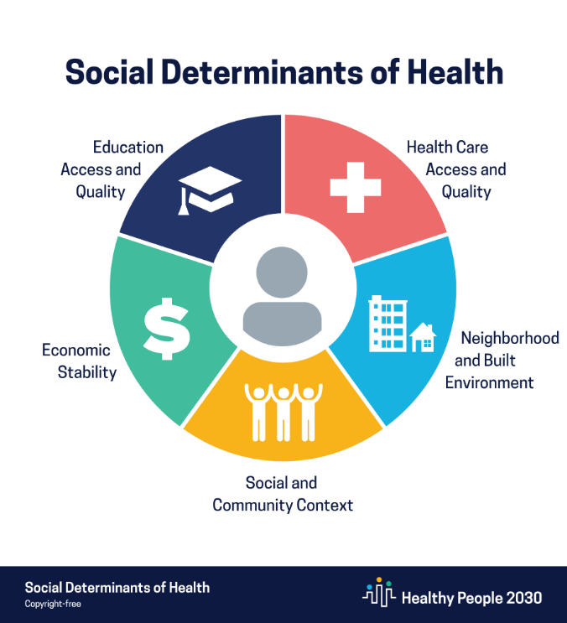
Why are Social Determinants of Health important to communities?
The social determinants of health are essential to community health.
The determinants help us understand, apply, and evaluate health policies and programs that affect the health of people, families, and their communities.
In collaboration with federal, state, and local community partners, relationships and common goals can be explored and relationships can be established to promote the health within communities.
(HP2030, 2021)

Slide 15
Nurses Role: Social Determinants of Health
As you go through the case study, look for social determinants of health for John. These will be summarized at the end.
Nurses must be able to recognize and address SDOH and population health needs.
Nurses often encounter at- risk populations and individuals and have an opportunity to improve the individual’s well-being and the overall health of the community.
Communities may lack many resources that contribute to community health such as grocery stores, transportation, affordable housing, and affordable childcare (examples of social determinants of health).

Slide 16
Homelessness
Four months after John’s injury and loss of job, he was evicted due to non-payment of rent.
He lived with his daughter Sophie at Star of Hope, a shelter for homeless families.
While at Star of Hope, he started rehabilitation at the Sobering Center but missed many appointments.
Defining Homelessness
Homelessness Statistics
What is the definition of homeless?
How many families are homeless in the US?

Slide 17
Sobering Center
Star of Hope
Figure 11. Sobering Center website homepage. Adapted from “Sobering Center”, retrieved from https://houstonrecoverycenter.org/sobering-center/
Figure 12. Star of Hope website homepage. Adapted from “Star of Hope”, retrieved from https://www.sohmission.org/

Slide 18
Homelessness
After three months, John was removed from the shelter for repeated alcohol and opioid use.
Star of Hope, as a mandatory reporter, made contact with Child Protective Services as John’s drug use and his daughter’s disability were areas of concern.
HE AND SOPHIE LIVED IN HIS VEHICLE FOR TWO WEEKS UNTIL HIS AUNT CLARA CONTACTED HIM AND OFFERED TO TAKE THEM IN UNTIL HE CAN “GET BACK ON HIS FEET”.
Homeless Children
How many children are homeless in the US?
What are some of the factors leading to homelessness?

Slide 19
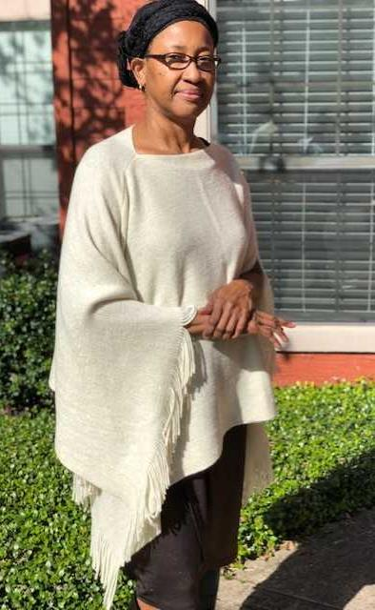
Mrs. Clara Miller
Aunt Clara’s Health Risks
Health Promotion
Raising Grandchildren
Texas Statistics on Grandparents Raising Children
John’s 70-year-old widowed aunt who lives alone in her small home in Baytown, has pension from teaching and owns her home
She encourages John, who is estranged from the rest of his family, to return to the VA for treatment of his substance abuse
Aunt Clara becomes Sophie’s caretaker and enjoys having Sophie in her home
But she is finding it difficult to care for an active young child due to her health conditions
What are leading causes of death for which Aunt Clara is at risk for considering her age, gender, and race?
What health promotion teaching could a nurse provide to Aunt Clara to help her improve her health?
How many grandparents and other older adults are raising young children?
What unique challenges do these family members face in child-rearing?
AUNT CLARA’S Health History
No history of tobacco use
Drinks occasional glass of red wine
Diagnosed with hypertension and takes “one pill every morning”
Has not been back for a follow-up appointment since starting this medication
Figure 13. Alexander. (2019, November 24). Aunt Clara posing outside of her home.

Slide 20
Declining Health
One evening, John is found in his car unresponsive. He is transported to the Texas Medical Center where it is confirmed that he has had a CVA as a result of untreated hypertension and past drug use.
Although John has health benefits through the VA for his mental health disorder and worker’s compensation for issues related to his arm amputation, he does not have general health insurance. He is transported to the county hospital for treatment.
He is admitted to the county hospital for treatment of the CVA which results in left-sided hemiparesis. The county hospital has a neuropsychiatric center and inpatient and outpatient rehabilitation services. John is depressed and frustrated by the added disability from the CVA and is also experiencing opioid withdrawal symptoms.
He is also worried about Sophie and Aunt Clara who are fifty minutes away from the county hospital and have not been able to visit him.
Healthcare Funding Terminology
How are county or other public hospitals funded?
What terminology is important for one to understand regarding funding?

Slide 21
Communication
S
Situation
Who is the person and what is happening with them?
Background
What is their clinical and social history?
Assessment
What is the problem?
Recommendation/Request
What would you do to correct the situation?
After an assessment of John’s needs and income, the county hospital arranged for John to receive home health and rehabilitation services at Aunt Clara’s home.
The home health nurse is often the bridge between inpatient and outpatient care for vulnerable clients such as John.
These clients often have multiple health problems that require treatment from multiple health care providers.
Effective communication, such as the SBAR technique, is essential to assure continuity of care.
B
A
R

Slide 22
S
B
A
R
Here is an example of SBAR communication for the handoff of John’s care from a discharge nurse to the home health agency.
What would a SBAR from the discharge nurse to mental health services include?
”Mr. Miller is a 35-year-old male with a left arm amputation. Mr. Miller was unable to afford medication for Hypertension and had a stroke resulting in left-sided hemiparesis 2 weeks ago. He requires physical therapy, and medication management.
He is on Soboxone for opioid addiction.
He is unemployed.”
”I’m calling about John Miller, a patient on our stroke unit.”
How would the SDOH impact John’s recovery?
“Mr. Miller requires home health nursing. Can you do an intake interview with him today?”
“Mr. Miller will be home bound requiring follow-up home health care.
Mr. Miller lives with his Aunt.
He will need assistance accessing resources to cover the expenses of rehabilitation.”
SBAR and Other Communication Techniques

Slide 23
Recovering Health
Based on the care plan for John, the home health agency provides weekly nurse visits to monitor John’s hypertension and recovery. He was discharged on Suboxone and was referred to a 12-step program.
The home health agency also provides an orderly or aide to bathe John and help with light housekeeping such as laundry and changing John’s bed linens.
John receives these services free of charge due to his low income.
John also receives telehealth services regarding management of his hypertension and stroke recovery through the county, and the VA has free psychiatric telehealth for his PTSD.
John is applying for SSI based on the disability from his amputation and the effects of the CVA. Due to his disabilities, John is unable to leave home without great difficulty and the use of medical transport and therefore is considered home-bound.
Home Health
What are the criteria to receive home health care?
How does home health care benefit the health of the community?

Slide 24
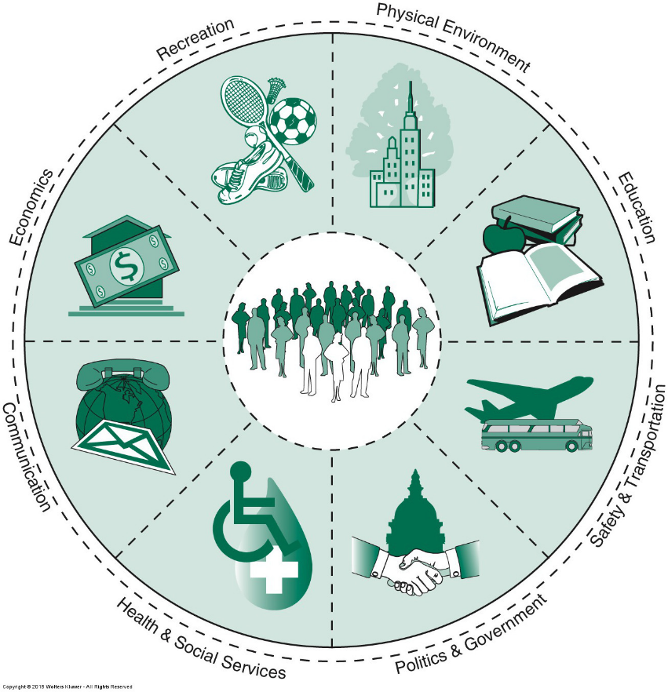
Windshield Survey
Baytown City Website
Baytown Economics
Poverty and Health
In the windshield survey that follows, identify how the community impacts John, his family and others.
Figure 16. From Community as Partner: Theory and Practice in Nursing (8th ed, Figure 11.3 The community assessment wheel, the assessment of segments of the community-as-partner model. p.179), by E. T. Anderson & J. McFarlane, 2019, Wolters Kluwer. Reprinted with permission.
Notes:
APA page 390 7th ed. BH
Figure 15. From Community as Partner: Theory and Practice in Nursing (8th ed, Figure 11.3 The community assessment wheel, the assessment of segments of the community-as-partner model. p.179), by E. T. Anderson & J. McFarlane, 2019, Wolters Kluwer. Reprinted with permission.
Figure 15. Illustration of the community assessment wheel. Adapted from “Community participation in teenage pregnancy prevention using the community-as-partner model”, retrieved from https://www.semanticscholar.org/paper/Community-participation-in-teenage-pregnancy-using-Oyedele-Wright/c41e911c679e1fd27a28e487e84160895eb3d129

Slide 25
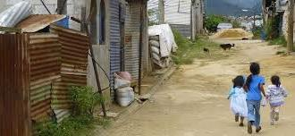
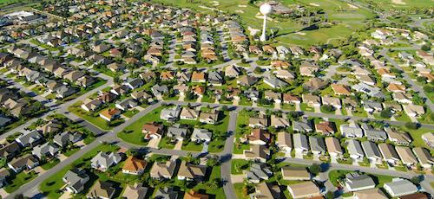
So how do we define a “Community”?
Let’s look at the World Health Organization (WHO) and how they define ”community”…
"Communities" are groups of people that may or may not be spatially connected, but who share common interests, concerns or identities. (WHO, 2020).
The windshield survey helps answer the question, ”How do the communities we live within affect our lives and healthy wellbeing?”
Figure 14. Children running in a low-income neighborhood. Adapted from ”PCI Announces Neighborhood Approach to Transform Urban Slums at the Clinton Global Initiative (CGI) Annual Meeting”, retrieved from https://www.pciglobal.org/pci-announces-neighborhood-approach-to-transform-urban-slums-around-the-world-at-the-clinton-global-initiative-cgi-annual-meeting/
Figure 15. Ariel view of a neighborhood community. Adapted from ”The Villages Florida”, retrieved from https://www.352area.com/florida/the-villages/

Slide 26
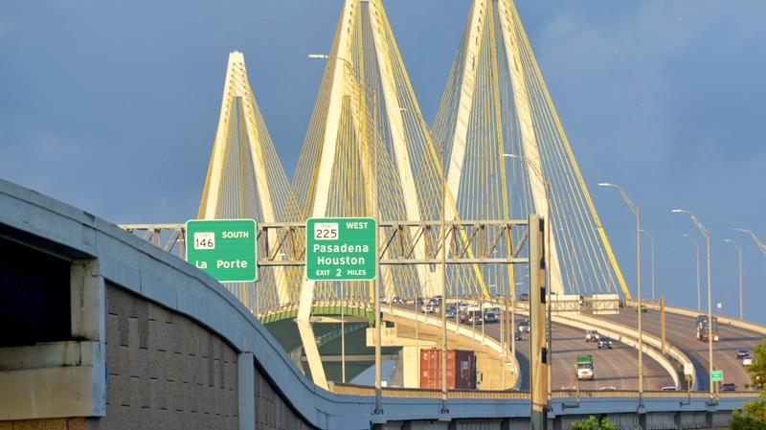
Baytown Texas
Figure 17. Fred Hartman bridge leading into Baytown, Texas. Adapted from “City of Baytown Website”, retrieved from https://www.baytown.org/discover-us/about

Slide 27
Windshield Survey
Baytown City Website
Baytown Economics
Poverty and Health
County Overview
Using the Assessment Wheel as your guide, conduct a digital community assessment of Baytown.
Health by
Zip Code
What is Baytown’s population?
What is the average age of the population in Baytown?
How does the poverty rate correlate with a community’s health?
Figure 18. From Community as Partner: Theory and Practice in Nursing (8th ed, Figure 11.3 The community assessment wheel, the assessment of segments of the community-as-partner model. p.179), by E. T. Anderson & J. McFarlane, 2019, Wolters Kluwer. Reprinted with permission.
Notes:
Figure 15.
Figure 15. Illustration of the community assessment wheel. Adapted from “Community participation in teenage pregnancy prevention using the community-as-partner model”, retrieved from https://www.semanticscholar.org/paper/Community-participation-in-teenage-pregnancy-using-Oyedele-Wright/c41e911c679e1fd27a28e487e84160895eb3d129

Slide 28
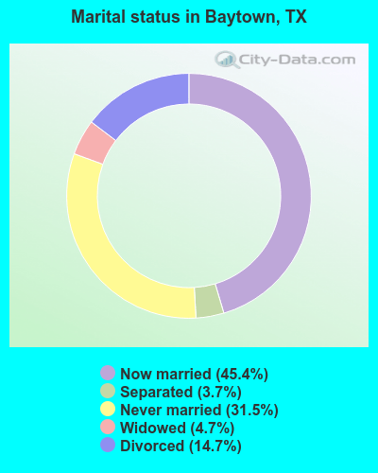
Less Than Half of Baytown’s Population is Married
Marital Status and Health
How does one’s marital status impact health?
What are the reasons for the reported health difference between married and unmarried people?
Figure 19. Graphical depiction of martial status in Baytown, Texas. Adapted from “City Data”, retrieved from https://www.city-data.com/

Slide 29
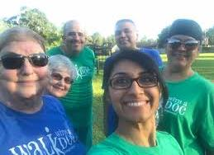
Baytown is diverse…
Figure 20. Baytown Cricket Club. Adapted from “The Baytown Sun”, retrieved from http://baytownsun.com/sports/article_3b7cf636-af3f-11e9-8bef-23e51e3c1675.html
Figure 21. Baytown Festival 2019 Flyer. Adapted from “Baytown Events”, retrieved from http://baytownevents.com/events/baytown-festival-taste-of-the-caribbean-celebration-2019/
Figure 22. Residents of Baytown, Texas posing at the “Walk With a Doc” event. Adapted from “Walk With a Doc”, retrieved from https://walkwithadoc.org/join-a-walk/locations/houston-tx-2/

Slide 30
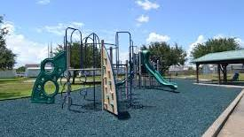
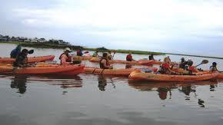
…with a lot to do.
Figure 23. Pirate’s Bay Waterpark in Baytown, Texas. Adapted from “The Scene Magazine”, retrieved from https://www.thescenemagazine.com/2015/06/06/149444/baytown-s-pirates-bay-waterpark-fun-for-the-family
Figure 24. Children enjoying a water slide at Pirate’s Bay Waterpark in Baytown, Texas. Adapted from “Kids Visitor”, retrieved from https://kidsvisitor.com/en/baytown/place/7807-pirates-bay-waterpark/
Figure 25. Briarwood Park in Baytown, Texas. Adapted from “Baytown City Website”, retrieved from https://www.baytown.org/city-hall/departments/parks-recreation/parks
Figure 26 Kayakers at the Eddie V Gray Wetlands Education Center in Baytown, Texas. Adapted from “Baytown City Website”, retrieved from https://www.baytown.org/city-hall/departments/parks-recreation/eddie-v-gray-wetlands-education-center

Slide 31
Physical Environment
Figure 27. Houston Ship Channel. Adapted from “Texas State Historical Association”, retrieved from https://tshaonline.org/handbook/online/articles/hdb01
Baytown’s major employer and source of tax income are the many oil refineries that are located there.
Refinery Risks
What does a refinery do and why are they vital to our nation?
What are some health risks associated with living near refineries?
What are some health risks of working at a refinery?

Slide 32
Physical Environment Baytown is on the Galveston bay with lovely scenery and opportunities for recreation.
Benefits of Health and Recreation
Why is recreation essential to a community’s health?
What populations may not be able to enjoy recreation in Baytown?
How can barriers to recreation be addressed at the community level?
Figure 28. Kayaking near the San Jacinto Monument. Adapted from “Visit Houston”, retrieved from https://www.visithoustontexas.com/houston-and-beyond/destinations/

Slide 33
Physical Environment
Figure 29. A flooded street after Hurricane Harvey. Adapted from “Inspire Investing”, retrieved from https://www.inspireinvesting.com/2017/09/01/where-is-god-when-houston-happens/flooded-street-full-of-people-evacuating-their-homes-rescue-hurricane-harvey-900new/
Baytown is subject to hurricanes and resulting flooding.
How can Baytown and its residents prepare for a weather emergency?
Why do individuals need to be prepared to survive for at least 3 days in a disaster?
What would a community disaster plan for Baytown include?
How do disasters impact a community’s mental health?
Psychology of a Crisis
Preparing for Disasters

Slide 34
Physical Environment
Baytown is also at risk for refinery fires and/or explosion.
How can Baytown and its residents prepare to shelter in place?
What supplies would Baytown residents need to shelter in place for this type of emergency?
What would a community disaster plan for Baytown include?
How do disasters impact a community’s mental health?
Baytown Explosion
Seek Shelter
Triage
What Is In That Smoke?
Figure 30. Exxon Mobile Baytown Complex Fire. Adapted from “KHOU News”, retrieved from https://www.khou.com/article/news/investigations/exxonmobils-baytown-plant-has-history-of-environmental-violations/285-5c60a4b4-e83b-43ec-a41a-96ec8a70d17b
.
What does “shelter in place” mean?
What health risks does an event like this one pose for Baytown residents?
How are victims of a disaster triaged?
Click on the link below to find out what chemicals petroleum plants can release

Slide 35
Housing in Baytown
Figure 31. $6.5 million estate in Baytown, Texas. Adapted from “Homes of the Rich”, retrieved from https://homesoftherich.net/2016/05/6-5-million-estate-in-baytown-tx/
Housing in Baytown varies from apartments to mansions; however most neighborhoods are middle-class with homes costing approximately $150,000.
How Does Housing Affect Health?
What health risks do low-income residents face who live in substandard housing?
As you read through the following slides consider: what health risks do low-income residents face from their community?
Figure 32. Low Income House in Baytown, Texas. Adapted from “Realtor.com”, retrieved from https://www.realtor.com/realestateandhomes-detail/58-County-Road-4006_Dayton_TX_77535_M74096-95113?view=qv

Slide 36
Figure 33. Graphical depiction of unemployment in Baytown, Texas. Adapted from “City Data”, retrieved from https://www.city-data.com/

Slide 37
Housing values in Baytown
Figure 34. Graphical depiction of house values in Baytown, Texas. Adapted from “City Data”, retrieved from https://www.city-data.com/

Slide 38
Based on the data, does the average Baytown resident make enough to own their own home?
Figure 35. Graphical depiction of median household income in Baytown, Texas. Adapted from “City Data”, retrieved from https://www.city-data.com/

Slide 39
Figure 36. Graphical depiction of most common industries in Baytown, Texas. Adapted from “City Data”, retrieved from https://www.city-data.com/

Slide 40
Figure 37. Graphical depiction of most common occupations in Baytown, Texas. Adapted from “City Data”, retrieved from https://www.city-data.com/

Slide 41
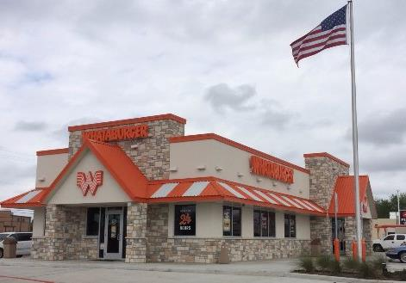
There are many restaurants in Baytown
Figure 38. A restaurant in Baytown, Texas. Adapted from “Yellow Pages”, retrieved from https://www.yellowpages.com/baytown-tx/mip/supermercado-la-vaquita-520814507
Figure 39. A restaurant in Baytown, Texas. Adapted from “Trip Advisor”, retrieved from https://www.tripadvisor.com/Restaurant_Review-g55456-d12399472-Reviews-Whataburger-Baytown_Texas.html

Slide 42
Eating Out
Over 61% of adults and 35% of school-age children
in Texas are obese.
How does eating out impact obesity?
How can restaurants help their patrons to eat a more healthful diet?
How does serving size differ from portion size?
How have portion sizes changed in the US over time?
How can one control portion sizes at home?
Fast Food
Portion Pitfalls
Portion Distortion

Slide 43
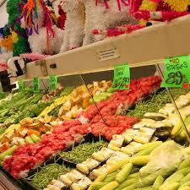
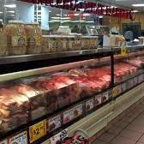
Grocery Stores
Figure 40. The produce section of a Food Town grocery store in Baytown, Texas. Adapted from “Four Square City Guide”, retrieved from https://foursquare.com/v/food-town/4c0c1b0ebbc676b05f974cd5
There are plenty of grocery stores in Baytown and a farmer’s market
Figure 41. An HEB grocery store in Baytown, Texas. Adapted from “Houston Public Media”, retrieved from https://www.houstonpublicmedia.org/articles/news/2017/12/06/254946/houstons-grocery-market-growing-fast-but-not-equally-across-the-region/
Food Desert
What is a food desert?
Why is the availability of quality food essential to community health?
Figure 42. A meat market in Baytown, Texas. Adapted from “La Michoacana Meat Market”, retrieved from https://www.lamichoacanameatmarket.com/en/4910-n-main-st-baytown-tx-77521/
Figure 43. Advertisement for a farmer’s market in Baytown, Texas. Adapted from “Local Harvest”, retrieved from https://www.localharvest.org/baytown-farmers-market-M74023

Slide 44
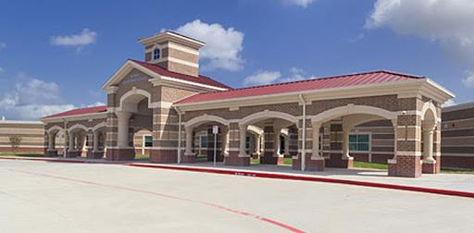
Education
Figure 44. Students pose at St. Joseph’s Catholic School in Baytown, Texas. Adapted from “St. Joseph’s Catholic School”, retrieved from http://stjosephbaytown.com/
Figure 45. Robert E. Lee High School in Baytown, Texas. Adapted from “Trinity Oaks Master Planned Community”, retrieved from https://trinityoaksmpc.com/schools-1
Figure 46. Alamo Elementary school in Baytown, Texas. Adapted from “School Construction News”, retrieved from http://schoolconstructionnews.com/2016/10/04/efficient-program-management-drives-267-million-goose-creek-cisd-makeover/

Slide 45
Baytown has:
Public schools (Pre-K to 12) located close to most neighborhoods
Community colleges
Referencing the graph, what is the education level of most people in Baytown?
How does one’s education level impact health?
What is health literacy and how does it differ from literacy?
How does a community’s education level impact health interventions?
How can nurses design effective teaching tools and experiences?
Health and Education
Health Literacy
Early Childhood Intervention Services
Figure 47. Graphical depiction of educational attainment in Baytown, Texas. Adapted from “City Data”, retrieved from https://www.city-data.com/

Slide 46
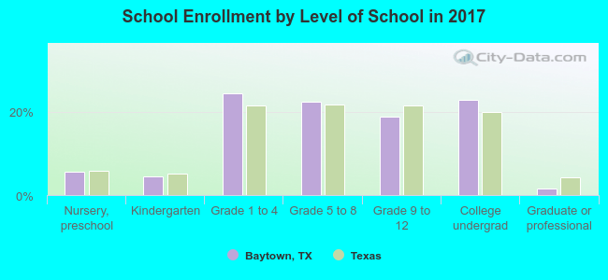
Figure 48. Graphical depiction of school enrollment in Baytown, Texas. Adapted from “City Data”, retrieved from https://www.city-data.com/

Slide 47
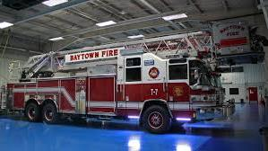
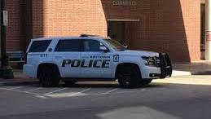
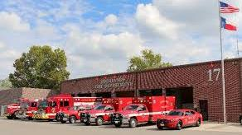
Safety
Figure 49. Baytown Police Officers. Adapted from “Baytown City Website”, retrieved from https://www.baytown.org/city-hall/departments/police
Figure 50. Baytown Fire Department Fire Engine. Adapted from “Fire Fighters Worldwide”, retrieved from http://www.firefightersworldwide.com/2016/02/virtual-tour/
Figure 51. Baytown Police SUV. Adapted from “Sutliff and Stout”, retrieved from https://www.sutliffstout.com/accident-reports/baytown-police-department-bpd-accident-reports/
Figure 52. Fire Department Vehicles. Adapted from “Highlands Fire Department”, retrieved from https://highlandsfire.com/

Slide 48
Baytown is served by its own police department and fire department.
How does the crime rate in Baytown compare to the national crime rate?
How can a community increase safety?
How does the presence of the refineries impact emergency services in Baytown?
Feeling Safe
Crime Statistics
Figure 53. Graphical depiction of crime in Baytown, Texas. Adapted from “City Data”, retrieved from https://www.city-data.com/

Slide 49
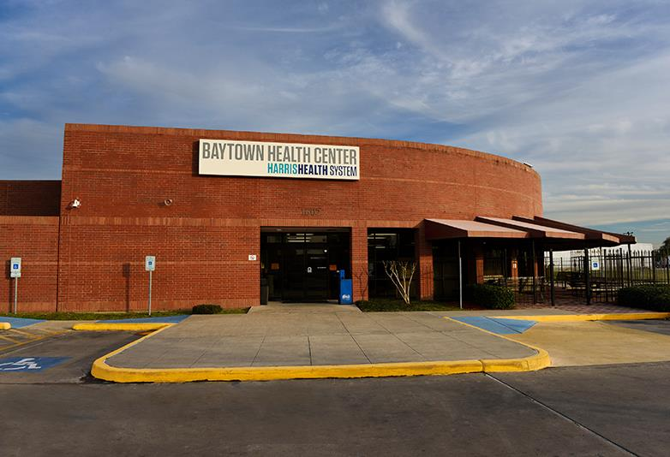
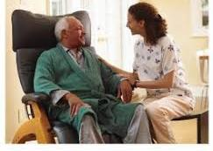
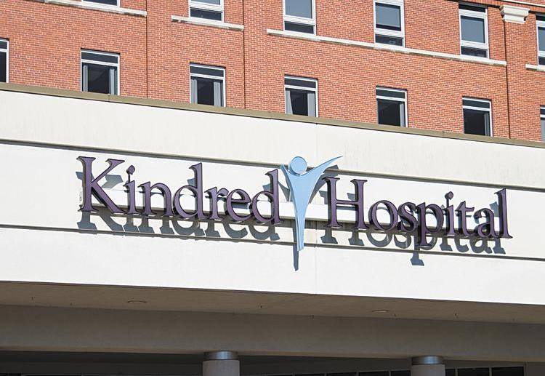
Health Care in Baytown
Four major hospitals
Most medical specialties
Home health and hospice available
35 miles from the Texas Medical Center
Figure 54. Baytown Health Center. Adapted from “Harris Health System”, retrieved from https://www.harrishealth.org/locations-hh/Pages/baytown-health-center.aspx
Figure 55. A patient receiving care in their home. Adapted from “Vitalis Healthcare”, retrieved from https://www.vitalishealthcare.com/
Figure 56. Kindred Hospital in Baytown, Texas. Adapted from “Biz Journals”, retrieved from https://www.bizjournals.com/louisville/news/2020/01/24/louisville-based-kindred-healthcare-closes-six.html
Figure 57. Altus Hospital in Baytown, Texas. Adapted from “Altus Hospital”, retrieved from https://altushospital.org/emergency-room/

Slide 50
Health Care: Only Part of the Picture
What is the difference between accessibility and availability?
How would greater insurance coverage impact the infant mortality rate in Texas?
What is Medicaid and what is its role in health care?
What are the top causes of death in Texas? How does this compare with the US?
How would greater health coverage impact the causes of death in Texas?
What is the infant mortality rate in TX?
How does the rate of uninsured in Texas impact the health of Texans?
How do deaths from overdose in Texas compare to the national rate?
77% of the population of Baytown has health insurance with over half of those having coverage through their employer.
Texas consistently ranks as the state with highest rate of uninsured.
Texas Uninsured Rate
Mortality in Texas
COVID-19 Mortality Overview
Texas Health Ranking

Slide 51
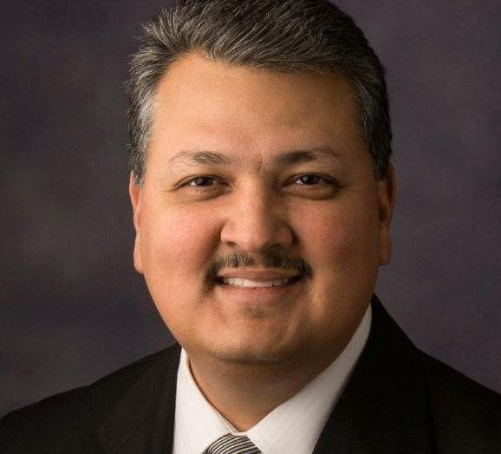
Government
Baytown has a mayor/city council government.
Texas has a governor and a legislature that meets biannually.
Figure 58. Baytown City Council. Adapted from “Baytown one vote away from no-kill resolution”, retrieved from https://www.adopttosave.org/pursuing-no-kill/2017/9/12/baytown-one-vote-away-from-no-kill-resolution
Participating in Government
Texas Votes
Voter Turnout
How can residents be involved in their government?
How can one tell whether the community is engaged in the political process?
What community groups may be underrepresented in the political process?
How can this be addressed?
How can nurses be represented in politics and government?
Figure 59. Baytown Mayor Brandon Capetillo. Adapted from “Message from Baytown mayor Brandon Capetillo”, retrieved from https://www.baytowncops.com/?p=14371

Slide 52
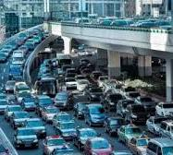
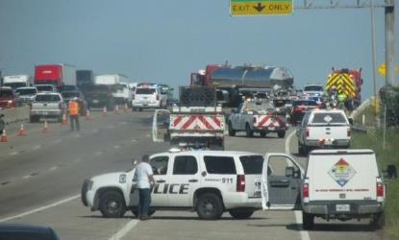
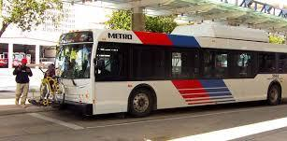
Transportation
Figure 60. Traffic Jam. Adapted from “The Value of Public Transit in Toronto”, retrieved from https://www.urbaneer.com/blog/Value_of_pubic_transit_in_toronto
Figure 61. Baytown police blocking a traffic accident scene. Adapted from “Accident in Baytown causes major traffic in interstate 10”, retrieved from https://fox4beaumont.com/news/local/gallery/accident-in-baytown-causes-major-traffic-on-interstate-10#photo-5
Figure 62. Metro System Bus. Adapted from “Metro Highlights”, retrieved from http://naboo.langranddev.com/pdfs/highlights.pdf

Slide 53
Transportation
Though Baytown Residents have access to public transportation, most still commute to work in their car.
The trade-off for using their own car is high pollution levels and monumental traffic.
Houston traffic consistently ranks as one of the worst in the nation.
What interventions could be implemented to decrease traffic deaths in Houston? Click on the Accidents link below and use the tool to determine what interventions could be used and what they would cost.
What is the impact of a long commute on health?
How can not having a car be a barrier to access to health care?
Stall and Crawl
Motor Vehicle Accidents
Effects of Commuting on the Body
Figure 63. Graphical depiction of means of transportation to work in Baytown, Texas. Adapted from “City Data”, retrieved from https://www.city-data.com/

Slide 54
Figure 64. Graphical depiction of travel time in Baytown, Texas. Adapted from “City Data”, retrieved from https://www.city-data.com/

Slide 55
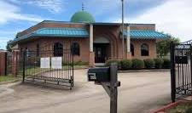
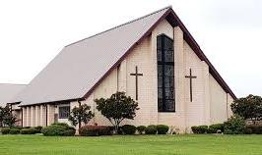
Spirituality
Self Care
COVID-19 and the Black Church
Religion and Public Life
AIDS and the Role of the Black Church
Figure 65. Masjid AlRahmah Mosque in Baytown, Texas. Adapted from “Facebook”, retrieved from https://www.facebook.com/AlRahmahbaytown/?ref=py_c
What is the difference between spirituality and religiosity?
How does spirituality fit into self-care?
How can you assess the spiritual/religious component of a community?
How can local congregations improve community health?
Figure 66. St. Mark’s United Methodist Church in Baytown, Texas. Adapted from “St. Mark’s United Methodist Church”, retrieved from https://stmarksbaytown.com/

Slide 56
According the graph what can you gather about religiosity in Harris county?
Figure 67. Graphical depiction of religion in Baytown, Texas. Adapted from “City Data”, retrieved from https://www.city-data.com/

Slide 57
Communication
Figure 68. Facebook Logo. Retrieved from https://www.facebook.com
Figure 69. KHOU News Logo. Retrieved from https://www.khou.com
Baytown has access to several newspapers and local TV stations. They have access to the internet and service for cell phones.
Social Media and Health
Let's chat
What would be the most effective way to communicate with a community such as Baytown?
How can a community’s demographics impact how one would communicate to the community?
What are ways that social media can be useful in communicating public health messages?
Figure 71. Houston Chronical Logo. Retrieved from https://www.chron.com/
Figure 70. The Baytown Sun Logo. Retrieved from https://www.baytownsun.com
Figure 72. ABC 13 News Logo. Retrieved from https://www.abc13.com/

Slide 58
Inference/Interpretation (Synthesis)
Look at each measurement area (i.e., infant mortality, crime rates, drop out rates)
What does all this mean?
How do we determine if a problem exists in Baytown?
What impacts John and his family?
Compare the measurement areas to a standard population
A standard population is one that contains the population of interest
Texas has a large, diverse population making it a good standard for comparison
This is the core of the community nursing diagnosis

Slide 59
Two Important Measures
Distribution
Tries to answer "who", "what", "when” and "where"
Counts frequencies and patterns of health events within groups in a population
Referred to as “descriptive epidemiology"
Determinants
Searches for causes or factors associated with increased risk or probability of disease
Tries to answer "how" and "why"
Referred to as "analytical epidemiology

Slide 60
Baytown’s Health
37% are obese.
Drug use is prevalent in Baytown.
63% used marijuana
25% used hard drugs
10% have diabetes
20% have hypertension
30% report being depressed
80% drink alcohol every month.
80% sexually active with 16 years being the average age of sexual debut.
The average number of lifetime sexual partners for males and females was 10.
Baytown residents report eating away from home 4 times per week
The average Baytown resident last saw a dentist 2 years ago
Many Baytown residents do not perform regular oral hygiene
18% report that they are embarrassed because of their teeth
¼ report having gum disease.
What do the numbers mean?

Slide 61
Baytown’s Health
Over half of Baytown residents reported smoking cigarettes.
Approximately one third of Baytown residents report getting exercise.
Over 20% of Baytown residents report some condition that either prevents them from working or limits the work that they can do.
Click on the provided link below to compare the health data for Baytown with a standard population.
What do the numbers mean?
Figure 73. Health and Wellness Graphic Art. Adapted from ”Health and Wellness Coaching”, retrieved from https://joinccba.org/health-wellness-coaching/

Slide 62
Baytown’s Health Services
What services does John and his daughter and Aunt Clara need?
VA and medication
Substance abuse treatment
VA and virtual therapy
Autism treatment
Childcare
Respite care
Figure 74. Health and Wellness Graphic Art. Adapted from ”Health and Wellness Coaching”, retrieved from https://joinccba.org/health-wellness-coaching/

Slide 63
Rates
Number of events in a specific time period
K
Population at risk in the same time period
*K is the base number (100, 1000)
Basic measures of disease or death occurrence in a defined population over a specified time period
Rates allow comparison between populations

Slide 64
Comparing Rates
In 2018 there were 94 robberies per 100,000 people in Baytown
In 2018 there were 98.5 robberies per 100,000 people in Texas
Texas Statistics
Baytown Statistics?
As we are able to compare rates per 100,000, Baytown has a lower rate of robberies than Texas.

Slide 65
Put it Together: Now that you’ve collected some data on Baytown, answer these questions:
What are the 3 top health problems in Baytown?
What are the top Health assets in Baytown?
Which problem would you choose to address and why?
What community assets are available to address the problem?
Why is it important to use rates for comparison of data rather than the number of events?

Slide 66
Community Health Nursing Diagnosis
Four parts of a community diagnosis
Health problem/risk
Affected aggregate or community
Identified cause
Evidence of health problem
Increased risk of
among
related to
as demonstrated by
Notes:
(Muecke, 1984)

Slide 67
Another Look at Community Nursing Diagnosis
Increased risk of
among
related to
as demonstrated in
(disability, disease, etc.)
(community or population)
(etiological statement, what causes the problem)
(health indicators, such as rates of vaccination, life expectancy)

Slide 68
Example of a Community Diagnosis
Risk of adult obesity/overweight status among residents of Baytown, TX related to a high prevalence of fast-food restaurants and knowledge deficit of portion control as evidenced by 66% of adults in Houston being overweight/obese and 66% of Texas adults being overweight/obese.
What other community health nursing diagnosis can you think of that is appropriate for Baytown?

Slide 69
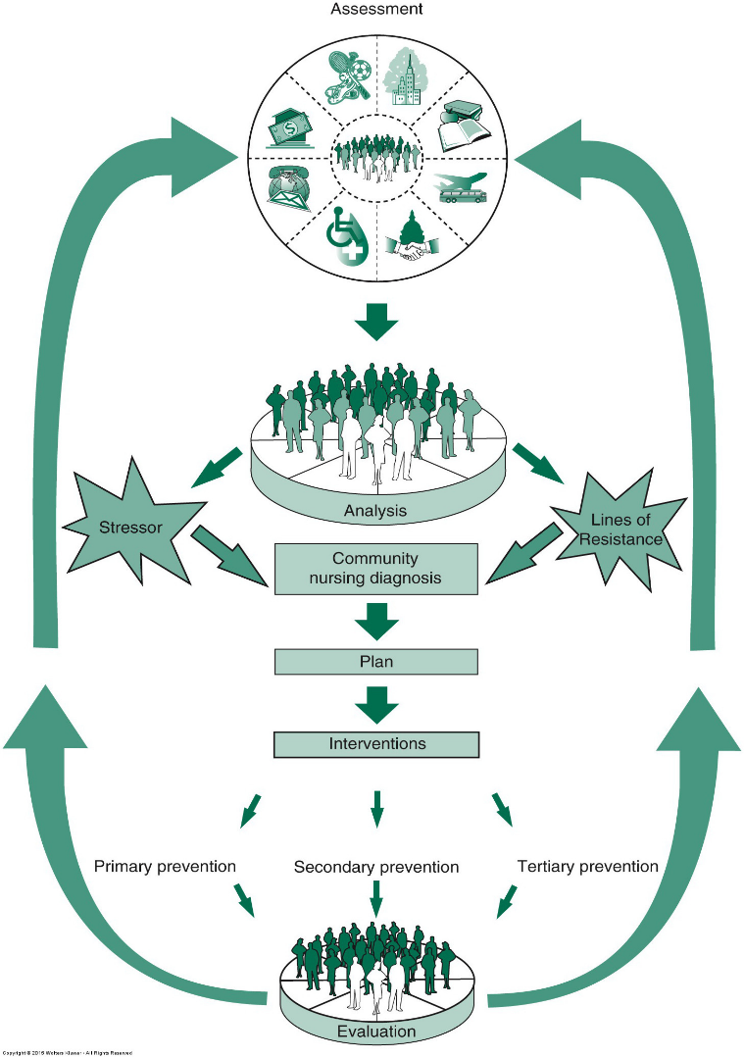
How do we help Baytown become a healthier community?
Figure 75. From Community as Partner: Theory and Practice in Nursing (8th ed, Figure 11.1 Community-as-partner model. p.174), by E. T. Anderson & J. McFarlane, 2019, Wolters Kluwer. Reprinted with permission.
Notes:
Jennifer this is one where figure number is needed updated.

Slide 70
What type of interventions can we do to help Baytown become a healthier community?
Primary Prevention
Secondary Prevention
Tertiary Prevention
Intervening to decrease the risk for onset of disease, injury, disability or death
(example: immunizations)
Early detection and treatment of disease or injury to prevent disability and death
(example: screening)
Treatment and rehabilitation to prevent disability
(example: medications, procedures, rehab)

Slide 71
Levels of Prevention
1˚=Stop the illness from occurring
S
2˚=Identify cases
I
3˚=Control Complications
C

Slide 72
Guiding Principles When Choosing Interventions
There are upstream, midstream, and downstream ways to address population health issues
Our behaviors and environment greatly influence our health and are often amenable to change
We must consider the social determinants of health in order to fully understand and address the health issue
Epidemiological data allows us to assess the magnitude of the problem and determine populations at risk
The following slides show an example of a health problem, heart disease, and levels of intervention
What are upstream interventions for Baytown’s high rate of dental disease?
What are some downstream interventions?
Is one approach better than the other?

Slide 73
Aunt Clara’s Risk: Preventing Heart Disease and Stroke Primary prevention involves teaching about ways to prevent heart disease and stroke through health promotion.
Smoking Cessation
daily exercise
adequate sleep
Stress Reduction technique such as meditation, participating in a hobby
a diet low in sodium, rich in fruit and vegetables, high in fiber

Slide 74
Aunt Clara’s Risk: Preventing death and disability from heart disease and stroke Secondary prevention is aimed at finding the presence of a disease or condition on the early stages before it can cause serious illness or death.
Secondary Prevention: Screen high risk individuals for:
High cholesterol
Hypertension
Obesity
Diabetes

Slide 75
Mr. Miller: Recovering stroke Tertiary prevention: aims to aid recovery from the damage done by the disease or condition.
Rehabilitation
Medication
Diet
Physical Therapy
Adaptive devices

Slide 76
Social Determinants of Health: Why are some people healthier than others?

Slide 77
What effects the health of all “communities”?
Social Determinants of Health: The range of personal, social, economic, and environmental factors that influence health status (Healthy People, 2020).
What makes us healthy or unhealthy?
What makes us sick or what keeps us well?
Education
Economic Stability
Social and Community Context
Neighborhood and Built Environment
Health and Health Care
Figure 76. Social Determinants of Health graphic. Adapted from ”Non-Medical Measures to Improve Public Health: What Works?”, retrieved from https://www.njspotlight.com/2019/02/19-02-20-new-guidance-on-non-medical-initiatives-to-improve-public-health/

Slide 78
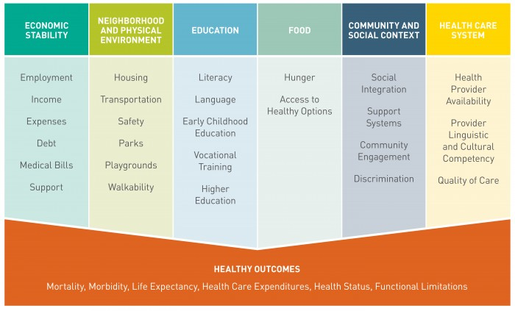
A Breakdown of Social Determinants of Health
Figure 77. Social Determinants of Health Graphic Art. Adapted from ”Social Determinants of Health-What are Payers Doing?”, retrieved from https://www.healthedge.com/blog-social-determinants-health-what-are-payers-doing

Slide 79
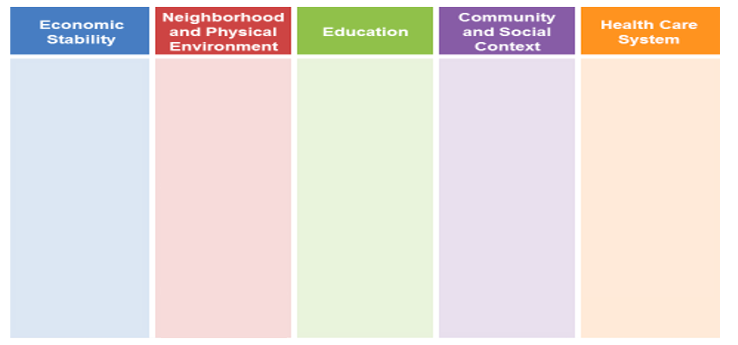
The SDOH: The Impact on Mr. Miller and His Family
Baytown’s 16% poverty rate
Employment
John’s employment status
Limited Employment opportunities in Baytown
Food Security
Good availability of Nutritious food
John’s ability to access and afford nutritious food
Safety net: food pantries
Food stamps
Johns’ family’s medical bills
John’s family’s income
Housing
Availability of affordable, safe housing in Baytown
Safety/Violence in Baytown
Food deserts
Walkability
Pollution/toxins in air, water, housing
Lead contamination
Grocery stores within walking distance
Police/fire response time
Transportation
Availability and accessibility of public transport
Bike trails/ Sidewalks
Quality Childcare
Early childhood education
Preschool programs for special needs children such as Sophie
Education resources at all levels Kindergarten through 12th grade
Educational Attainment in Baytown
Graduation/drop out rates in Baytown
John’s educational attainment
Literacy level in Baytown
John’s reading grade level
Discrimination
Minority Employment Rate
Diverse staffing in schools, Fire and Police departments
Mental Health
Supports for individuals and families impacted by mental illness/substance abuse
Criminal Justice System
Veterans’ court
Jail diversion programs
Social Support Systems
Peer group support
Substance abuse
Deaths in Baytown related to substance abuse
Parenting skills
Child abuse
Quality of care in Baytown
John’s ability to access care
Insurance coverage
Medicaid
Medicare
Travel time to medical facilities
Availability of care for all ages
Behavioral/speech therapy
Availability of primary specialty care

Slide 80
John’s New Normal
John no longer abuses alcohol or opioids.
He continues on Suboxone and is attending a virtual 12-step program several times weekly.
John and Sophie are living with Aunt Clara
Aunt Clara is receiving respite care from a local faith-based organization and can better manage her health.
Aunt Clara wants to continue to care for Sophie and help John.
Figure 78. Photo of ‘John’ in new normal. Printed with permission S. Justin May 7, 2016.

Slide 81
References
References
ABC 13. (2020). ABC 13 News Logo https://www.abc13.com/
Accident in Baytown causes major traffic in Interstate 10. (n.d.). Baytown police blocking a traffic accident scene [Photograph]. Fox4Beaumont.com. https://fox4beaumont.com/news/local/gallery/accident-in-baytown-causes-major-traffic-on-interstate-10#photo-5
Alexander, J. (2019, November 24). Aunt Clara posing outside of her home [Photograph].
Alexander, J. (2020, January 16). Sophie going to school [Photograph].
Altus Hospital. (2020). Emergency room in Altus Hospital in Baytown, Texas [Photograph]. https://altushospital.org
Anderson, E. T. & J. McFarlane. (2019). Community as partner: Theory and practice in nursing (8th ed). Wolters Kluwer.
Baytown Events. (2019). Baytown Festival 2019 Flyer [Photograph with text]. http://baytownevents.com/events/baytown-festival-taste-of-the-caribbean-celebration-2019/
Baytown Health Center. (n.d.). Outside of front of Harris Health Center Harris Health System [Photograph]. Harris Health System. https://www.harrishealth.org/locations-hh/Pages/baytown-health-center.aspx
Baytown one vote away from no-kill resolution. (2017, August 25). Baytown City Council [Photograph]. https://www.adopttosave.org/pursuing-no-kill/2017/9/12/baytown-one-vote-away-from-no-kill-resolution
Baytown Police Officers. Adapted from “Baytown City Website”, retrieved from https://www.baytown.org/city-hall/departments/police
The Baytown Sun. (2020). The Baytown Sun Logo https://www.baytownsun.com
Baytown City Website. (n.d.a). Briarwood Park in Baytown, Texas [Photograph]. https://www.baytown.org/city-hall/departments/parks-recreation/parks
Baytown City Website. (n.d.b). Kayakers at the Eddie V. Gray Wetlands Education Center in Baytown, Texas [Photograph]. https://www.baytown.org/city-hall/departments/parks-recreation/eddie-v-gray-wetlands-education-center
Bunn,C. (2021, March 8). Black churches have become indispensable in Covid-19 vaccination effort. NCB Universal. Retrieved March 19, 2021 from https://www.nbcnews.com/news/nbcblk/black-churches-become-indispensable-covid-19-vaccination-effort-rcna364
Carter, M. (n.d.). Defendant standing before a judge [Photograph]. Adapted from “Judge Marc Carter”, https://judgemarccarter.com/
City-Data.com. (2020a). Graphical depiction of marital status in Baytown, Texas [Chart]. https://www.city-data.com/
City-Data.com. (2020b). Graphical depiction of unemployment in Baytown, Texas [Chart]. Adapted from “City Data”, retrieved from https://www.city-data.com/
City-Data.com. (2020c). Graphical depiction of house values in Baytown, Texas [Chart]. https://www.city-data.com/
City-Data.com. (2020d). Graphical depiction of median household income in Baytown, Texas [Chart]. https://www.city-data.com/
City-Data.com. (2020e). Graphical depiction of most common industries in Baytown, Texas [Chart]. https://www.city-data.com/
City-Data.com. (2020f). Graphical depiction of most common occupations in Baytown, Texas [Chart]. https://www.city-data.com/
City-Data.com. (2020g). Graphical depiction of educational attainment in Baytown, Texas [Chart]. https://www.city-data.com/
City-Data.com. (2020h). Graphical depiction of school enrollment in Baytown, Texas [Chart]. https://www.city-data.com/
City-Data.com. (2020i). Graphical depiction of crime in Baytown, Texas [Chart]. https://www.city-data.com/
City-Data.com. (2020j). Graphical depiction of means of transportation to work in Baytown, Texas [Chart]. https://www.city-data.com/
City-Data.com. (2020k). Graphical depiction of travel time in Baytown, Texas [Chart]. https://www.city-data.com/
City-Data.com. (2020l). Graphical depiction of religion in Baytown, Texas [Chart]. https://www.city-data.com/

Slide 82
References
References
City of Baytown Website. (2014). Fred Hartman bridge leading into Baytown, Texas [Photograph]. https://www.baytown.org/discover-us/about
Coboreba, A. (2017, August). Military benefits: Military discharge notice [Clip art]. http://militarybenefitspangeshi.blogspot.com/2017/06/military-benefits-dishonorable-discharge.html
Dale, A. (2019, July 26). Baytown cricket club [Photograph]. The Baytown Sun. http://baytownsun.com/sports/article_3b7cf636-af3f-11e9-8bef-23e51e3c1675.html
Facebook. (2020). Facebook Logo [Clip art]. https://www.facebook.com
Four Square City Guide. The produce section of a Food Town grocery store in Baytown, Texas [Photograph]. https://foursquare.com/v/food-town/4c0c1b0ebbc676b05f974cd5
Grom, J. P. (2016, October 4). Alamo Elementary school in Baytown, Texas [Photograph]. School Construction News.http://schoolconstructionnews.com/2016/10/04/efficient-program-management-drives-267-million-goose-creek-cisd-makeover/
Health and Wellness Coaching. (n.d.). Health and Wellness [Clip art]. Carter Community Building Association. https://joinccba.org/health-wellness-coaching/
Healthy People 2020 [Internet]. (2020). Social determinants of health. Retrieved February 15, 2020, from https://www.healthypeople.gov/2020/topics-objectives/topic/social-determinants-of-health
Healthy People 2030, U.S. Department of Health and Human Services, Office of Disease Prevention and Health Promotion. [Internet]. (2020). Retrieved March 25, 2021, from https://health.gov/healthypeople/objectives-and-data/social-determinants-health
Hearst. (2020). Houston Chronical Logo [Clip art]. https://www.chron.com/
Highlands Fire Department. (2020). Fire Department Vehicles [Photograph]. https://highlandsfire.com/
Homes of the Rich. (2016, May 5). $6.5 million estate in Baytown, Texas [Photograph]. https://homesoftherich.net/2016/05/6-5-million-estate-in-baytown-tx/
Houston Public Media. (n.d.). An HEB grocery store in Baytown, Texas [Photograph]. https://www.houstonpublicmedia.org/articles/news/2017/12/06/254946/houstons-grocery-market-growing-fast-but-not-equally-across-the-region/
Houston Recovery Center. (2020). Man lying on bed in a shelter [Photograph]. Sobering Center: A Safe Place to Get Sober. https://houstonrecoverycenter.org/sobering-center/
Justin, S. (n.d.). Early military photo of Army. Printed with permission.
Justin, S. (2016, May 7). Photo of ‘John’ in new normal. Printed with permission.
Kidsvisitor. (2020). Children enjoying a water slide at Pirate’s Bay Waterpark in Baytown, Texas [Photograph].https://kidsvisitor.com/en/baytown/place/7807-pirates-bay-waterpark
KHOU 11. (2020). KHOU News Logo [Clip art]. https://www.khou.com
KLSA News. (2013, April 29). Soldier suffering from PTSD [Photograph]. https://www.ksla.com/story/22110456/ptsd-treating-the-silent-enemy-with-hearts-4-heroes/
La Michoacana Meat Market. (n.d.). A meat market in Baytown, Texas [Photograph]. https://www.lamichoacanameatmarket.com/en/4910-n-main-st-baytown-tx-77521/
Local Harvest. (2020). Advertisement for a farmer’s market in Baytown, Texas [Photograph]. https://www.localharvest.org/baytown-farmers-market-M74023
Masjid AlRahmah Mosque Baytown. (n.d.). Masjid AlRahmah Mosque in Baytown [Photograph]. In Facebook.https://www.facebook.com/AlRahmahbaytown/?ref=py_c
McKay, D. R. (2019, July 27). Electrician Cartoon [Clip art]. The Balance Careers. https://www.thebalancecareers.com/electrician-526009
Mercedes, C. (2019, July31). Exxon Mobile Baytown Complex Fire [Photograph]. KHOU News. https://www.khou.com/article/news/investigations/exxonmobils-baytown-plant-has-history-of-environmental-violations/285-5c60a4b4-e83b-43ec-a41a-96ec8a70d17b

Slide 83
References
References
Message from Baytown Mayor Brandon Capetillo. (2020, March 16). Baytown Mayor Brandon Capetillo [Photograph]. BaytownCops. https://www.baytowncops.com/?p=14371
Metro Highlights. (2018, September). Metro System Bus [Photograph]. Metropolitan Transit Authority of Harris County http://naboo.langranddev.com/pdfs/highlights.pdf
Moore, C. (2015, June 6). Pirate’s Bay Waterpark in Baytown, Texas [Photograph]. The Scene Magazine. https://www.thescenemagazine.com/2015/06/06/149444/baytown-s-pirates-bay-waterpark-fun-for-the-family
Myarea Network. (n.d.). Ariel view of a neighborhood community [Photograph]. The Villages Florida.https://www.352area.com/florida/the-villages/
Netzly, R. (2017, August 31). A flooded street after Hurricane Harvey [Photograph]. Inspire Investing. https://www.inspireinvesting.com/2017/09/01/where-is-god-when-houston-happens/flooded-street-full-of-people-evacuating-their-homes-rescue-hurricane-harvey-900new/
Optizen Labs. (2016). Finger pressing button. [Clip art]. http://optizenlabs.com/pl/tag/case-study/
Pew Research Center. (2021). Religion and public life. Retrieved March 19, 2021 from https://www.pewforum.org/
Pixabay. (n.d.). Military man holding gun [Photograph]. Retrieved June 26, 2020 from https://pixabay.com/photos/soldier-shooting-training-exercise-2533669/
Project Concern International. (2020). Children running in a low-income neighborhood [Photograph]. PCI Announces Neighborhood Approach to Transform Urban Slums at the Clinton Global Initiative (CGI) Annual Meeting. https://www.pciglobal.org/pci-announces-neighborhood-approach-to-transform-urban-slums-around-the-world-at-the-clinton-global-initiative-cgi-annual-meeting/
Pulsinelli, O. & Larson, C. (2020, January 24). Sign on front of Kindred Hospital in Baytown, Texas [Photograph]. Biz Journals. https://www.bizjournals.com/louisville/news/2020/01/24/louisville-based-kindred-healthcare-closes-six.html
Realtor.com. (n.d.). Low income house in Baytown, Texas [Photograph]. Retrieved June 29, 2020 from https://www.realtor.com/realestateandhomes-detail/58-County-Road-4006_Dayton_TX_77535_M74096-95113?view=qv
St. Mark’s United Methodist Church Baytown. (2020). St. Mark’s United Methodist Church in Baytown, Texas [Photograph]. https://stmarksbaytown.com/
Stainton, L. H. (2019, February 21). Social Determinants of Health [Clip art]. From Non-Medical Measures to Improve Public Health: What Works? NJSpotlight. https://www.njspotlight.com/2019/02/19-02-20-new-guidance-on-non-medical-initiatives-to-improve-public-health/
Social Determinants of Health-What are Payers Doing? (n.d.). Social Determinants of Health [Clip Art]. HealthEdge. https://www.healthedge.com/blog-social-determinants-health-what-are-payers-doing
St. Joseph’s Catholic School. (2020). Students pose at St. Joseph’s Catholic School in Baytown, Texas [Photograph]. Catholic Schools: The Archdiocese of Galveston-Houston. http://stjosephbaytown.com/
Star of Hope Mission. (2020). Mother holding daughter next to Star of Hope information [Photograph on webpage with text]. https://www.sohmission.org/
Stout, H. (2018, August). Baytown Police SUV [Photograph]. Sutliff and Stout. https://www.sutliffstout.com/accident-reports/baytown-police-department-bpd-accident-reports/
Sputnik News. (2016). Military tank [Photograph]. https://sputniknews.com/military/201609111045187046-russia-tank-division-formation/
Texas Health and Human Services. (2021). Early childhood intervention services. Retrieved March 19, 2021 from https://hhs.texas.gov/services/disability/early-childhood-intervention-services
Texas State Historical Association. (n.d.). Houston Ship Channel [Photograph]. https://tshaonline.org/handbook/online/articles/hdb01

Slide 84
References
Trinity Oaks Master Planned Community. (2018). Robert E. Lee High School in Baytown, Texas [Photograph]. https://trinityoaksmpc.com/schools-1
Trip Advisor. (2020). A restaurant in Baytown, Texas [Photograph]. https://www.tripadvisor.com/Restaurant_Review-g55456-d12399472-Reviews-Whataburger-Baytown_Texas.html
The Value of Public Transit in Toronto. (2020). Traffic Jam [Photograph]. Urbaneer.com. https://www.urbaneer.com/blog/Value_of_pubic_transit_in_toronto
Virtual tour: Baytown fire department Pierce Quantum 100 Platform. (2016). Baytown Fire Department Fire Engine [Photograph]. First Arriving. http://www.firefightersworldwide.com/2016/02/virtual-tour/
Visit Houston. (n.d.). Kayaking near the San Jacinto Monument [Photograph]. https://www.visithoustontexas.com/houston-and-beyond/destinations/
Vitalis Healthcare. (2015). A patient receiving care in their home [Photograph]. https://www.vitalishealthcare.com/
Walk With a Doc. (2020). Residents of Baytown, Texas posing at the “Walk With a Doc” event [Photograph]. https://walkwithadoc.org/join-a-walk/locations/houston-tx-2/
Watchtower Security. (2019, March 7). Camp Hope building sign [Photograph]. https://watchtower-security.com/camp-hope-providing-new-hope-to-veterans-and-their-families
West, A. (2010, December 11). Workplace injury prevention signs [Clip art]. Hive Health Medi. https://www.hivehealthmedia.com/workplace-injury-prevention/
Yellow Pages. (n.d.). A restaurant in Baytown, Texas [Photograph]. https://www.yellowpages.com/baytown-tx/mip/supermercado-la-vaquita-520814507

Slide 85
John’s Journey: Caring for Vulnerable Populations in the Community
2020 © Barbara E. Hekel, Bridgette Pullis, Juane Alexander, Christina DesOrmeaux,
and Allison Edwards
Authorized by AACN

